Slide 1
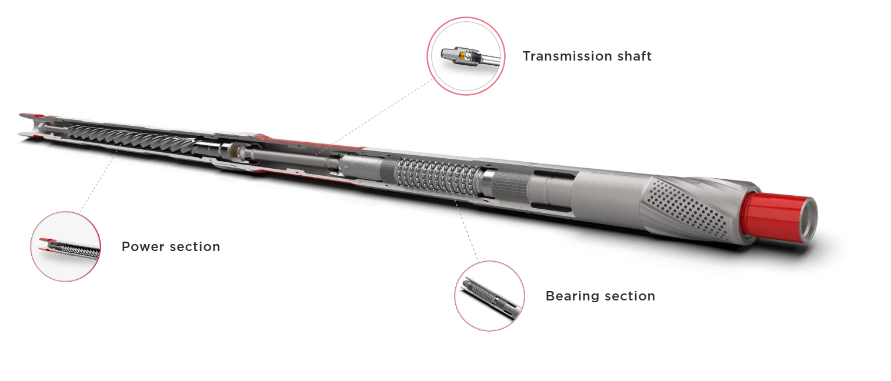
Welcome to the
8” Drillex Mud Motor
Services

Slide 2
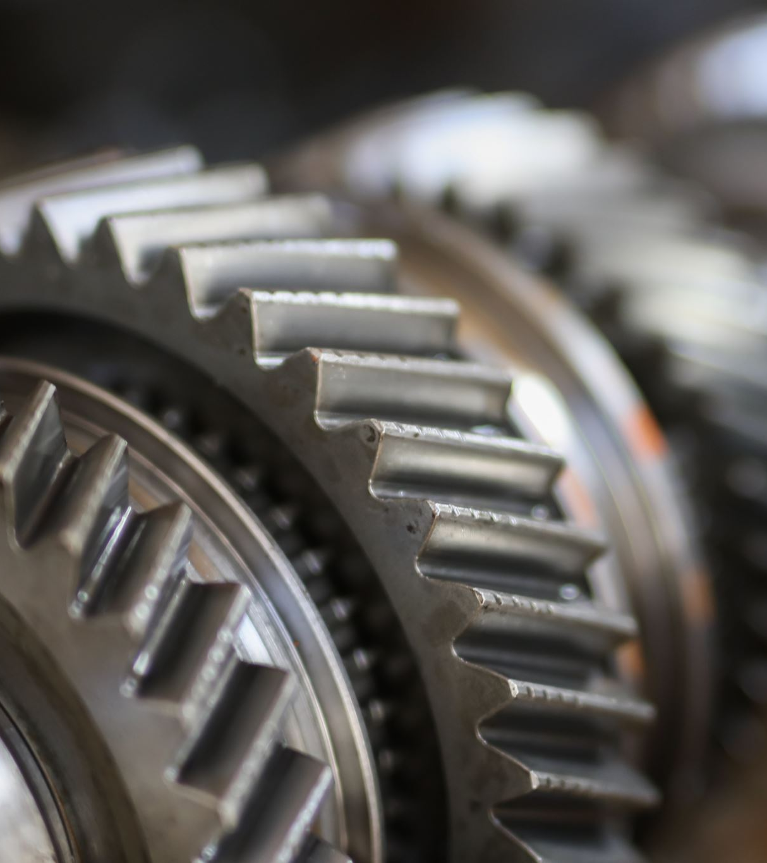
Overview
Mud motors, also known as positive displacement motors (PDMs), are essential tools in directional drilling operations. For 8-inch borehole applications, the Drillex Mud Motor is prominent tools known for their durability, efficiency, and directional control.

Slide 3
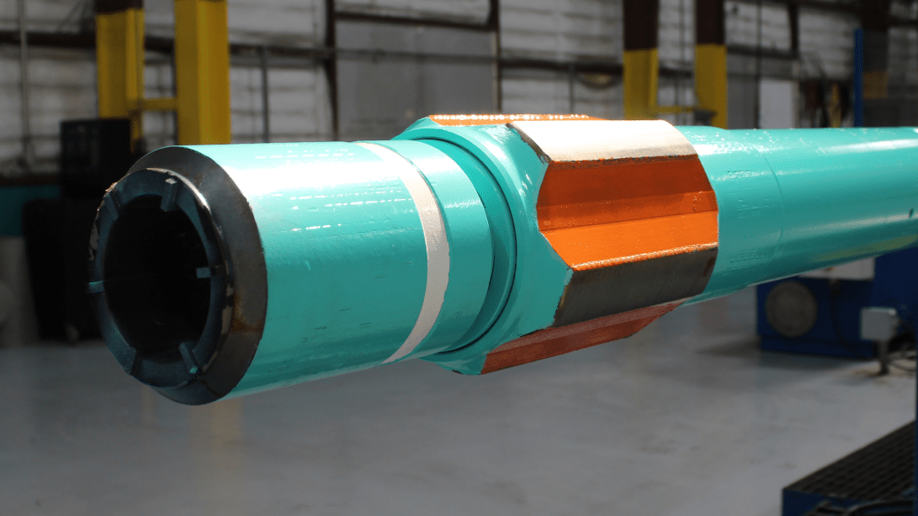
Drillex Mud Motor (8")

Slide 4
Manufacturer Overview
Drillex Tools is a globally recognized manufacturer of high-performance downhole drilling equipment specializing in high-performance mud motors engineered for large-diameter boreholes and demanding downhole conditions in oil, gas, and geothermal drilling in designing and engineering premium-grade Positive Displacement Motors (PDMs), power sections, and other drilling components used extensively in both conventional and unconventional well operations.
Drillex Tools is a globally trusted manufacturer of advanced downhole motors. The 8-inch Drillex Mud Motor is engineered for large-diameter, high-demand drilling operations, delivering robust torque, exceptional durability, and reliable directional control in oil, gas, and geothermal wells.

Slide 5
Mechanical and Design Features of the 8” Drillex Mud Motor
Power Section
  Precision-machined rotor-stator assembly optimized for high torque and durability in large borehole applications.
  Advanced elastomer compounds capable of operating in HPHT environments exceeding 200°C (392°F) and aggressive downhole conditions.
  Typical lobe configurations such as 6:7 and 7:8, balancing rotational speed and torque output for efficient drilling.

Slide 6
Bearing Assembly
Heavy-duty, sealed bearing packs featuring premium carbide radial and thrust bearings designed to withstand extreme axial and radial loads common in 8-inch drilling.
Adjustable Bent Housing (ABH)
Adjustable bend angles from 0° to 3°, enabling precise directional drilling with tight radius build capabilities.
Motor Length and Modularity
Motor sections engineered for modularity, allowing quick field servicing and component replacement.
Available in both mud-lubricated and oil-filled sealed designs, depending on drilling fluid compatibility and maintenance preferences.
Short bit-to-bend distances to enhance responsiveness and steering accuracy in complex well profiles.
Optimized length balancing robustness and flexibility for extended reach and horizontal drilling.

Slide 7
Design Features
High-torque performance enabled by an advanced rotor-stator assembly optimized specifically for 8-inch size applications, delivering maximum torque and rotational speed balance.
Adjustable bent housing with variable bend angles typically ranging from 0° to 3°, facilitating precise directional control and tight-radius wellbore trajectory adjustments.
Premium high-temperature elastomers designed to withstand harsh HPHT environments, supporting temperatures up to 200°C (392°F) and exposure to corrosive drilling fluids.
Short bit-to-bend distance engineered to enhance steering accuracy and enable rapid build rates in complex directional drilling operations.
Robust bearing assemblies incorporating carbide radial and thrust bearings to withstand high axial and radial loads, providing increased durability in abrasive and high-load downhole conditions.
Optional Enhancements & Add-Ons
Integration with Measurement While Drilling (MWD) and Logging While Drilling (LWD) tools.
Shock absorber modules and anti-drop subs for enhanced bottom hole assembly (BHA) stability.
Customizable mud flow diverters to optimize cooling and drilling fluid circulation.
Deep directional wells, extended reach drilling, and geothermal projects.
Abrasive and hard formations including carbonates and sandstones.
High-pressure, high-temperature wells requiring durable, high-torque motors.

Slide 8
Operational Capabilities and Advantages
Performance in High-Demand Environments
Ideal for deep, high-angle, and horizontal wells where maximum torque and power are essential.
Withstands high WOB (weight on bit) and downhole pressures, maintaining consistent rate of penetration in hard and abrasive formations.
Drilling Efficiency
Advanced elastomer and bearing technologies increase run life and reduce maintenance intervals.
Vibration damping design improves bit life and drilling stability.
Versatility
Compatible with a wide range of drill bits (PDC, tricone, hybrid) and drilling fluid types.
Suitable for HPHT and abrasive well conditions encountered in oil, gas, and geothermal drilling.
Durability & Maintenance
Drillex motors are engineered for longer downhole life, reducing NPT (Non-Productive Time).
Components are field-repairable, with full support for spare parts and service kits.

Slide 9
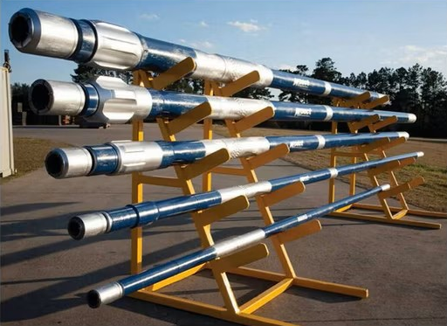
Drillex Mud Motor (8")

Slide 10
Manufacturer Overview
Drillex HDD designs reliable, cost-effective mud motors optimized for horizontal directional drilling (HDD) and mid-depth oilfield applications.
The 7-inch Drillex Mud Motor delivers a balance of performance and affordability for larger borehole drilling projects.
Drillex HDD produces reliable, cost-efficient mud motors primarily designed for horizontal directional drilling (HDD) and mid-depth oilfield drilling.
The 8-inch Drillex Mud Motor is engineered to provide dependable performance in larger borehole operations with a focus on ease of maintenance and affordability.

Slide 11
Mechanical and Design Features of the 8” Drillex Mud Motor
Standard and high-torque elastomer options tailored for 8-inch motors, designed to perform effectively in soft to medium-hard formations.
Rotor-stator lobe ratios typically range from 4:5 to 7:8, optimized to balance torque and RPM for HDD and directional drilling.
Power Section
  Standard and high-torque elastomer options tailored for 8-inch motors, designed to perform effectively in soft to medium-hard formations.
  Rotor-stator lobe ratios typically range from 4:5 to 7:8, optimized to balance torque and RPM for HDD and directional drilling.

Slide 12
Bearing Assembly
Modular, field-serviceable bearing packs available in sealed and mud-lubricated configurations.
Bent Housing Design
Fixed or adjustable bent housing options with bend angles up to 2.5°, facilitating precise directional control and smooth build/hold profiles.
Motor Length and Compatibility
Compact modular design supports rig floor space optimization and quick assembly.
Bearings designed for longevity and ease of replacement, minimizing rig downtime.
Bent housing geometry optimized for effective steering in HDD and mid-depth oilfield wells.
Compatible with standard HDD steering tools and wireline/MWD telemetry systems.

Slide 13
Design Features
High-performance elastomer compatibility engineered for durability with various drilling fluid types, including abrasive and high-temperature muds.
Optimized power section providing an efficient torque-to-speed ratio suitable for 7-inch drilling operations in soft to medium-hard formations.
Choice of sealed or mud-lubricated bearing assemblies offering flexibility based on application requirements and ease of maintenance.
Adjustable bent housing available with bend angles up to 2.5°, enabling precise steering control in horizontal and directional drilling.
Modular design allowing quick field servicing and part replacement to minimize downtime.
Steering tool housings for walk-over or wireline guided HDD operations.
Large-scale HDD projects including pipeline and conduit installation.
Shock subs and vibration dampeners to extend bit and motor life.
Compatibility with downhole transmitters (sondes) for navigation.
Multiple bit box configurations (API, IF) for flexible tooling options.
Mid-depth directional oilfield wells where moderate torque and reliable performance are required.
Civil infrastructure projects emphasizing cost efficiency and operational reliability.

Slide 14
Operational Capabilities and Advantages
Optimized for HDD and Mid-Depth Drilling
Suited for utility conduit installations, pipeline HDD crossings, and moderate-depth directional wells.
Performs well in unconsolidated soils, clays, gravel, and soft rock formations.
Ease of Maintenance and Cost Efficiency
Designed for rapid rebuilds with widely available parts and minimal specialized tooling.
Lower total cost of ownership (TCO) through reduced service times and maintenance costs.
Drilling Performance
Effective torque delivery with compatible flow rates for medium to large rigs (80–300 GPM).
Stable operation in various drilling fluids, including abrasive and polymer-based muds.
Durability
Hardened housing surfaces and internal coatings protect against abrasive wear and chemical degradation.
Sealed components reduce risk of premature failure due to mud contamination.

Slide 15
Comparative Summary
Feature | Drillex Mud Motor (8") | Drillex Mud Motor (8")
Build Rate Capability | High (up to 3.5°/100 ft) | Moderate (up to 2.5°/100 ft)
Torque Output | Very High | Moderate
Durability | Excellent for HPHT & abrasive | Good, abrasion resistant
Typical Applications | Deep, HPHT, hard rock wells | HDD, mid-depth oilfield, utilities
Maintenance Complexity | Moderate, field serviceable | Easy, fast rebuild
Cost | Higher upfront investment | More economical

Slide 16
Conclusion
The 8-inch Drillex Mud Motor is purpose-built for high-performance, heavy-duty drilling requiring superior torque, precision steering, and durability in HPHT and abrasive conditions.
The 8-inch Drillex Mud Motor provides a cost-effective, reliable solution for HDD and mid-depth oilfield applications, emphasizing ease of maintenance and operational efficiency.

Slide 17
Thank You For Staying With Us
Have A Nice Day and Work Safe

